Slide 1

Introduction to Operating Systems CS/COE 1550
Spring 2020-2021
Sherif Khattab
ksm73@pitt.edu
(Some slides are from Silberschatz, Galvin and Gagne ©2013)

Slide 2
Announcements
Upcoming deadlines:
4/9: Lab 4
4/13: Quiz 3
4/14: Homework 11
4/16: Homework 12
4/23: Lab 5
4/26: Project 4 (File System) – to be posted today
5/2: Quiz 4
Tophat questions due one week after each lecture
OMETs
1 bonus point when response rate >= 80%

Slide 3
Last Lecture …
File System Implementation
Directories
Free block management

Slide 4
Muddiest Points (1/2)
Free block tracking
for free block tracing with linked lists how is it not a linked list of disk blocks.
Bitmap in free block tracking
Handling long file name directories and how putting the heap at the end of the directory limits the file size
how index nodes work
what an i-node is
I-node allocation vs linked/contiguous allocation
Does the i node replace the FAT in fast file? Or is it what makes up the FAT?
cd rom
What are the attributes that are stored in a directory entry?

Slide 5
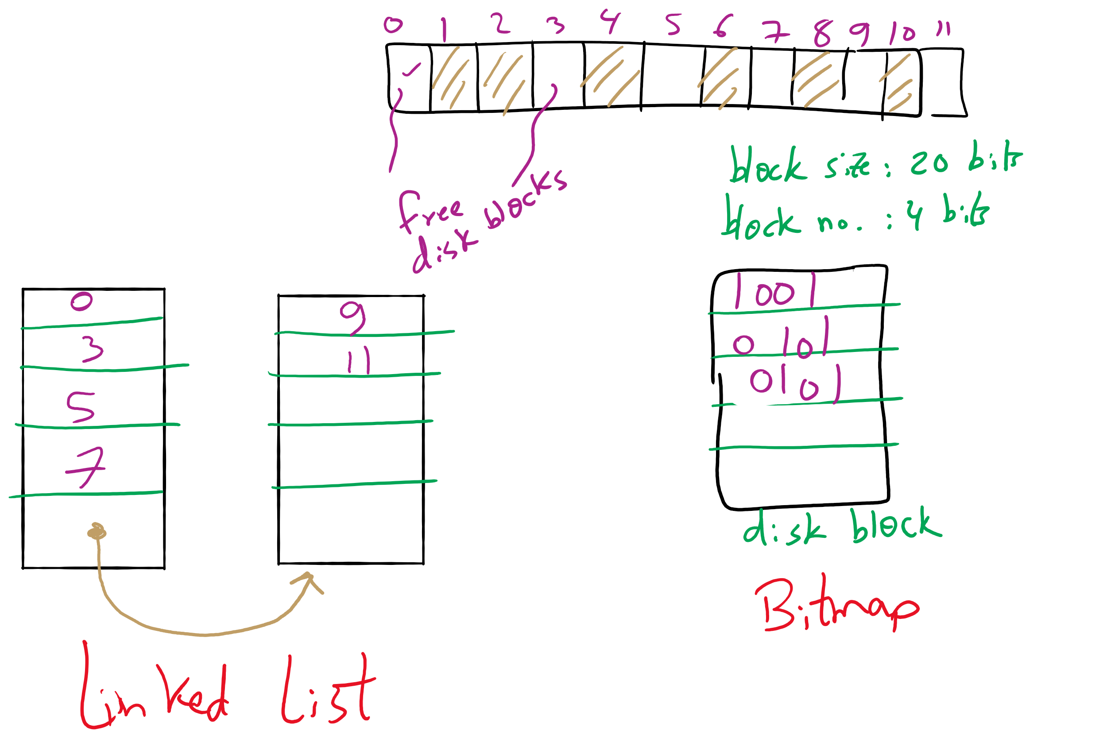
Free Block Tracking Example 1

Slide 6
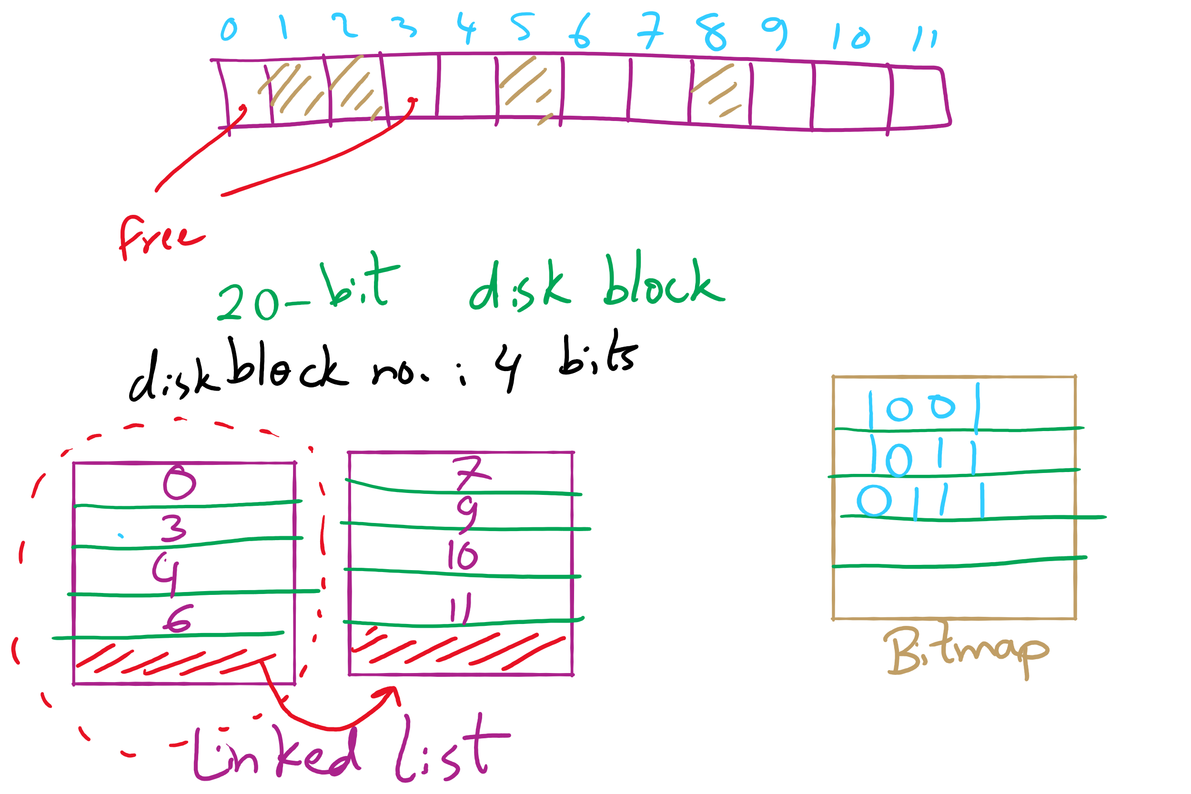
Free Block Tracking Example 2

Slide 7
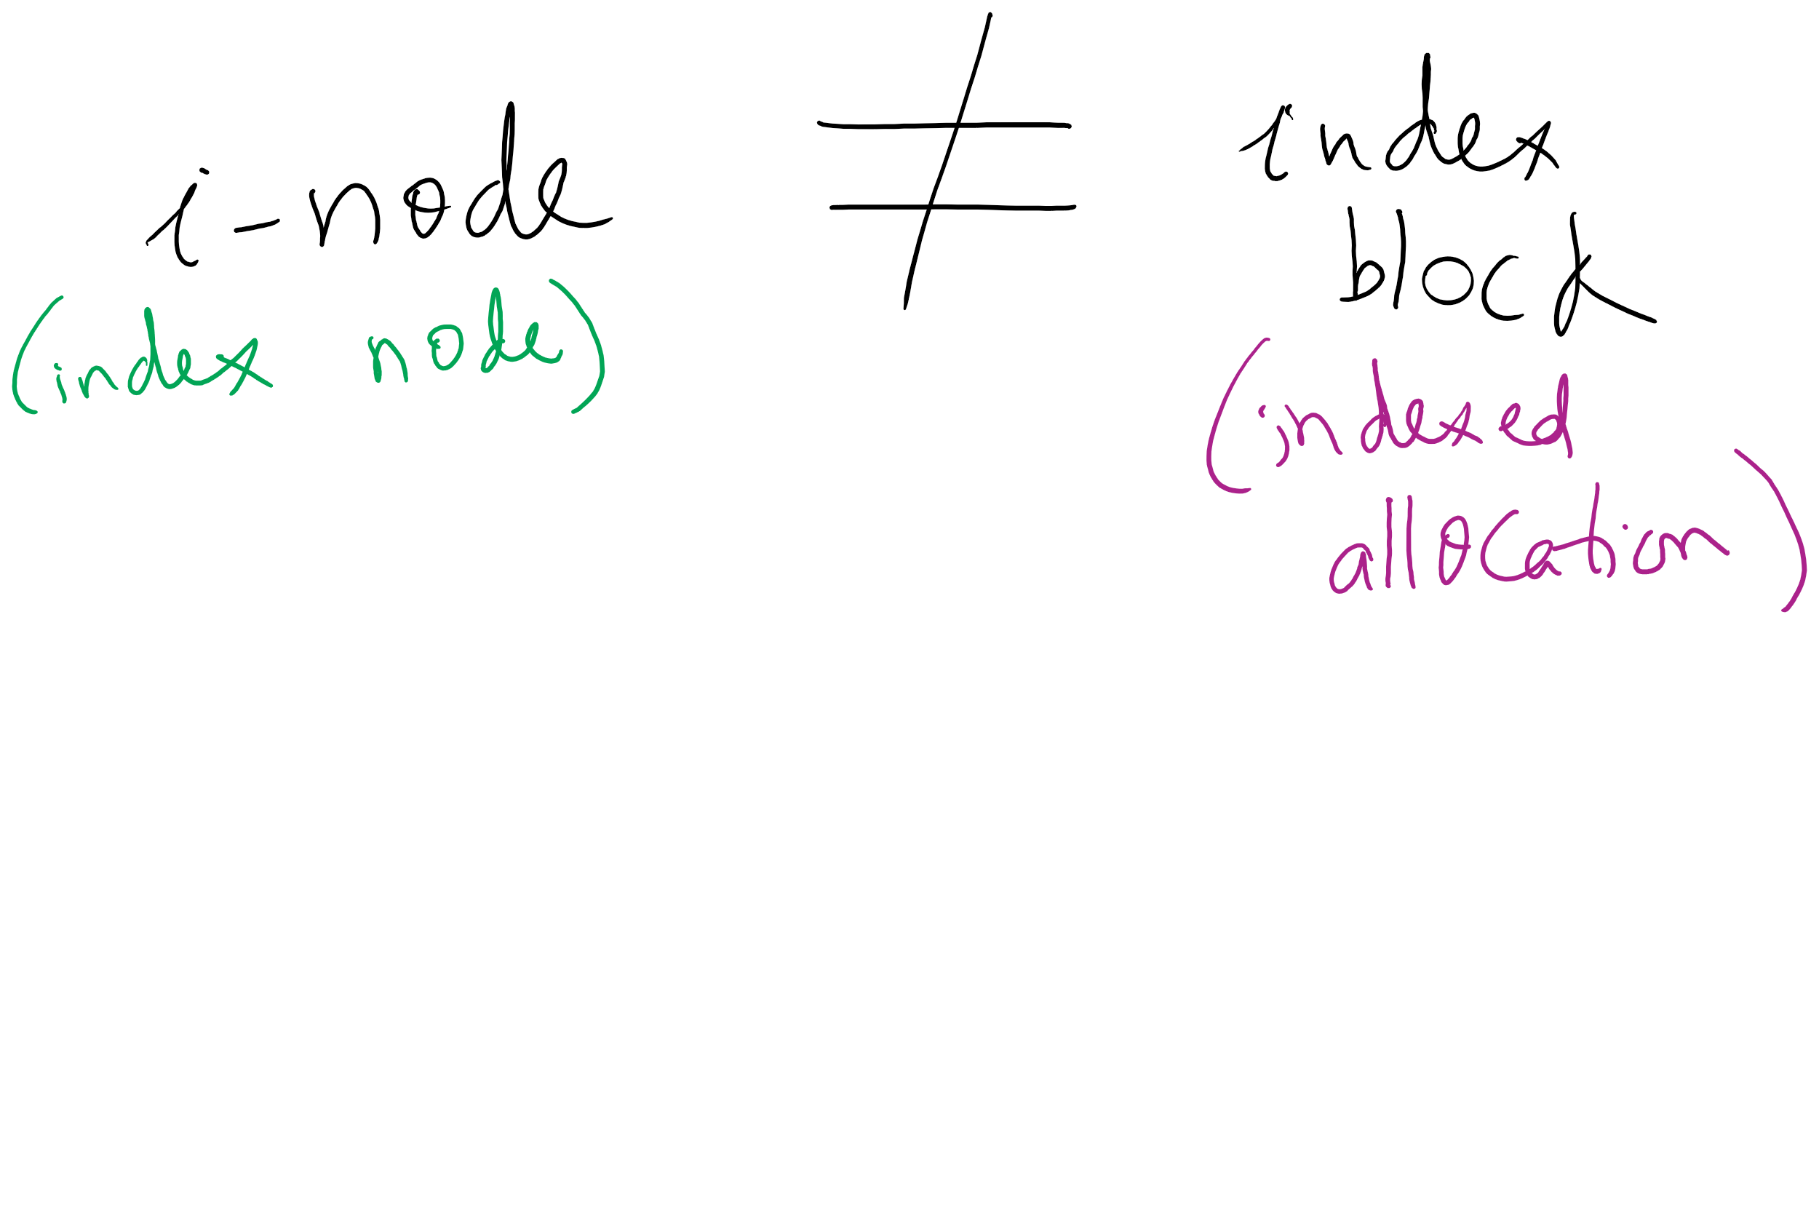
i-node vs index block

Slide 8
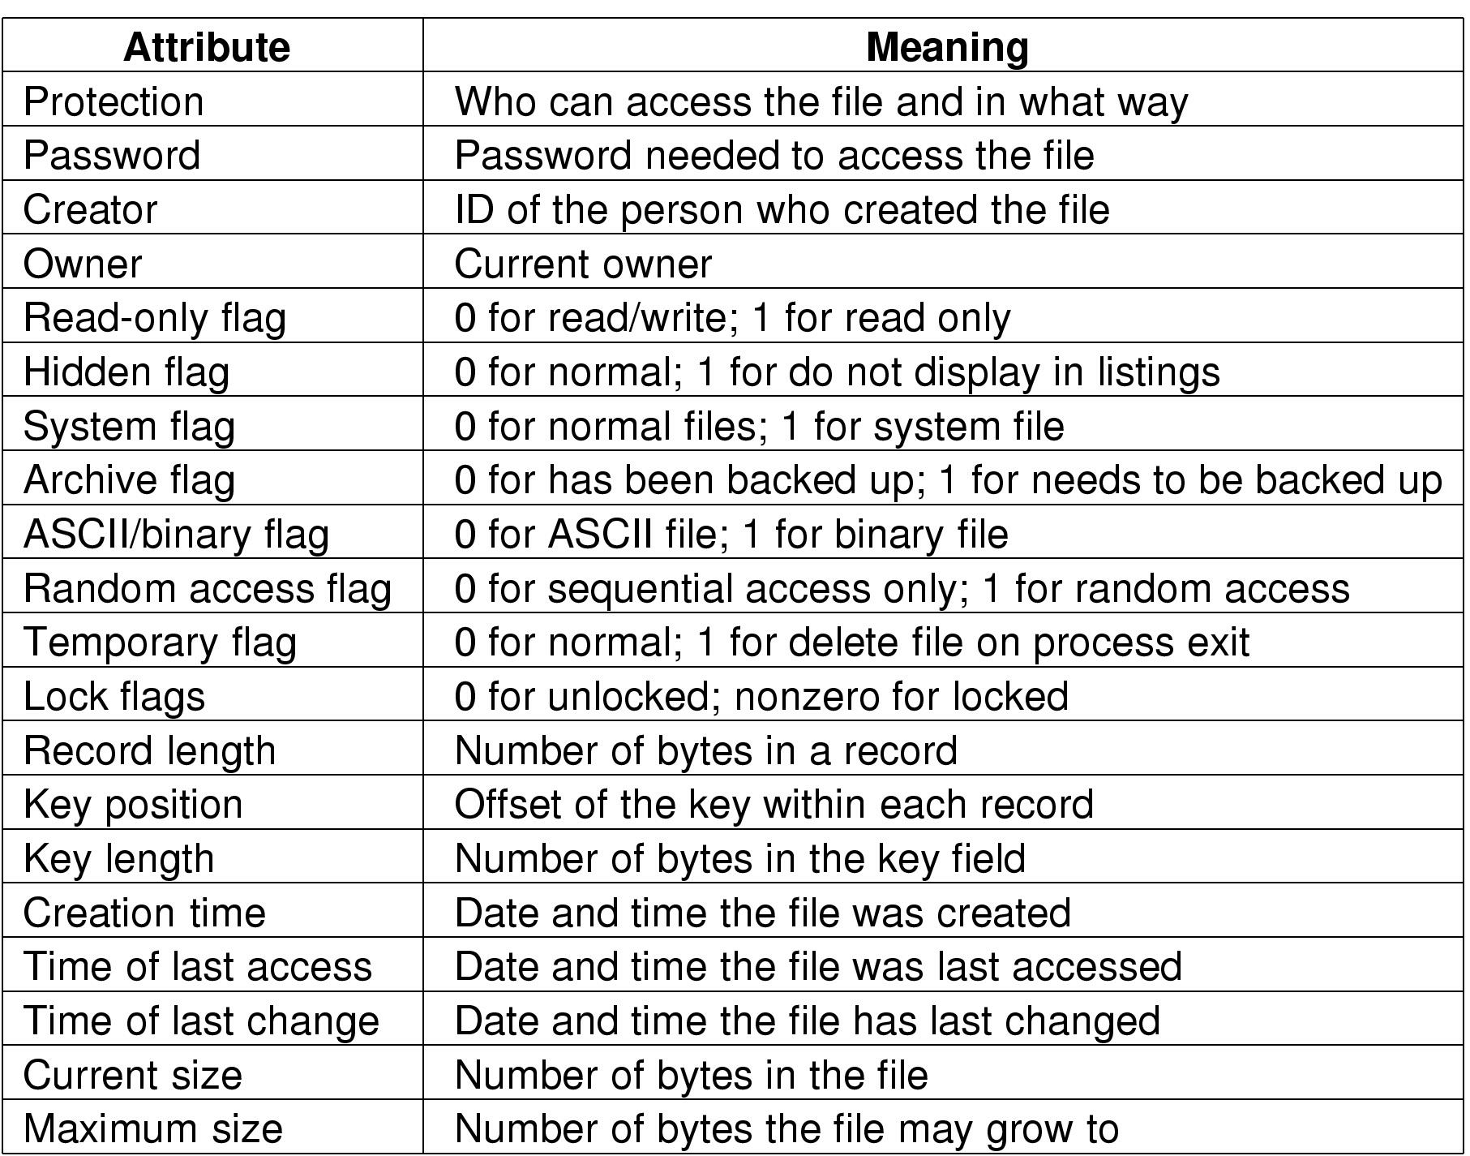
File attributes

Slide 9
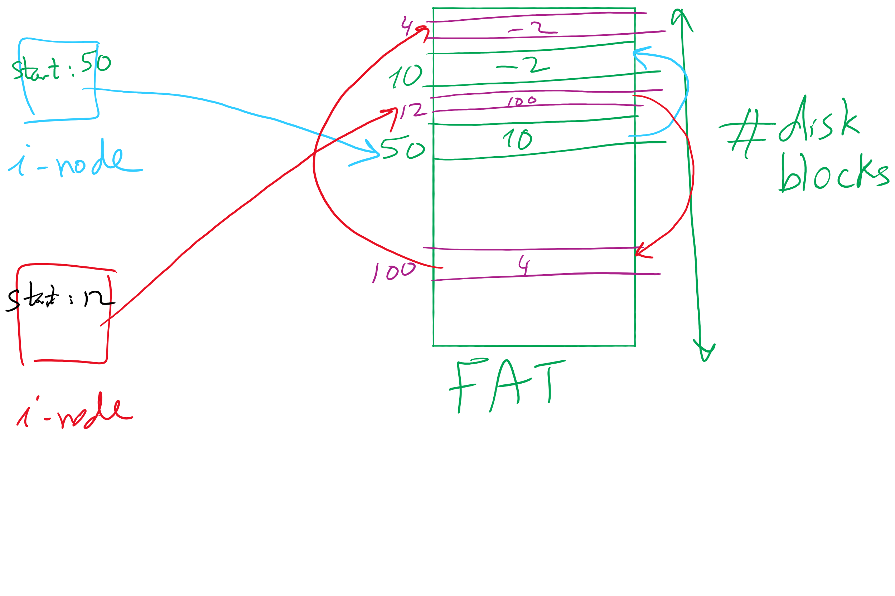
i-node and FAT

Slide 10
Muddiest Points (2/2)
I heard the project 4 is on file systems and is the hardest one in the class. Any thing we should be keying onto right now while we're learning about file systems that are fundamental/helpful for the project?
For MS-DOS directories, what is the reserved section for?
In the Windows 98 directory example, how are the fake directory entries containing the rest of the directory name associated with the real one?
The process for storing a backwards compatible file name
File Sharing
After a file has been shared, can the owner revoke access to, unshare, a file? Additionally, since a lot of systems consider directories to be "special files," are links also used to share directories or is there a different solution?
Persisting problems with shared files
Variable-size file name
Pros and Cons of the different methods for variable sized entry for storing long names.
Confused on why exactly long file names are an issue

Slide 11

Project 4 Hint

Slide 12
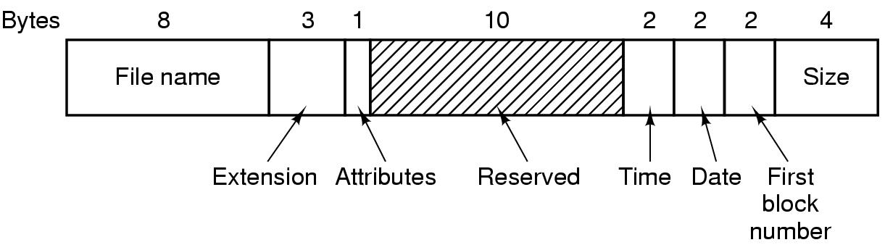

Slide 13
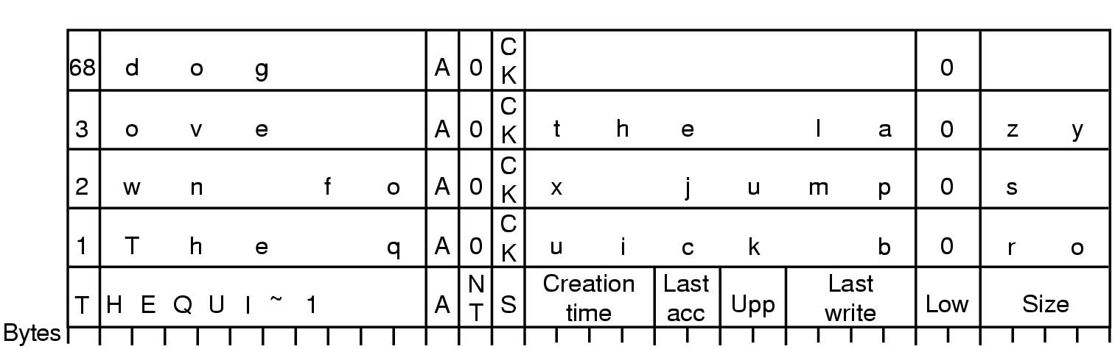
FAT-32 Directory Entry

Slide 14
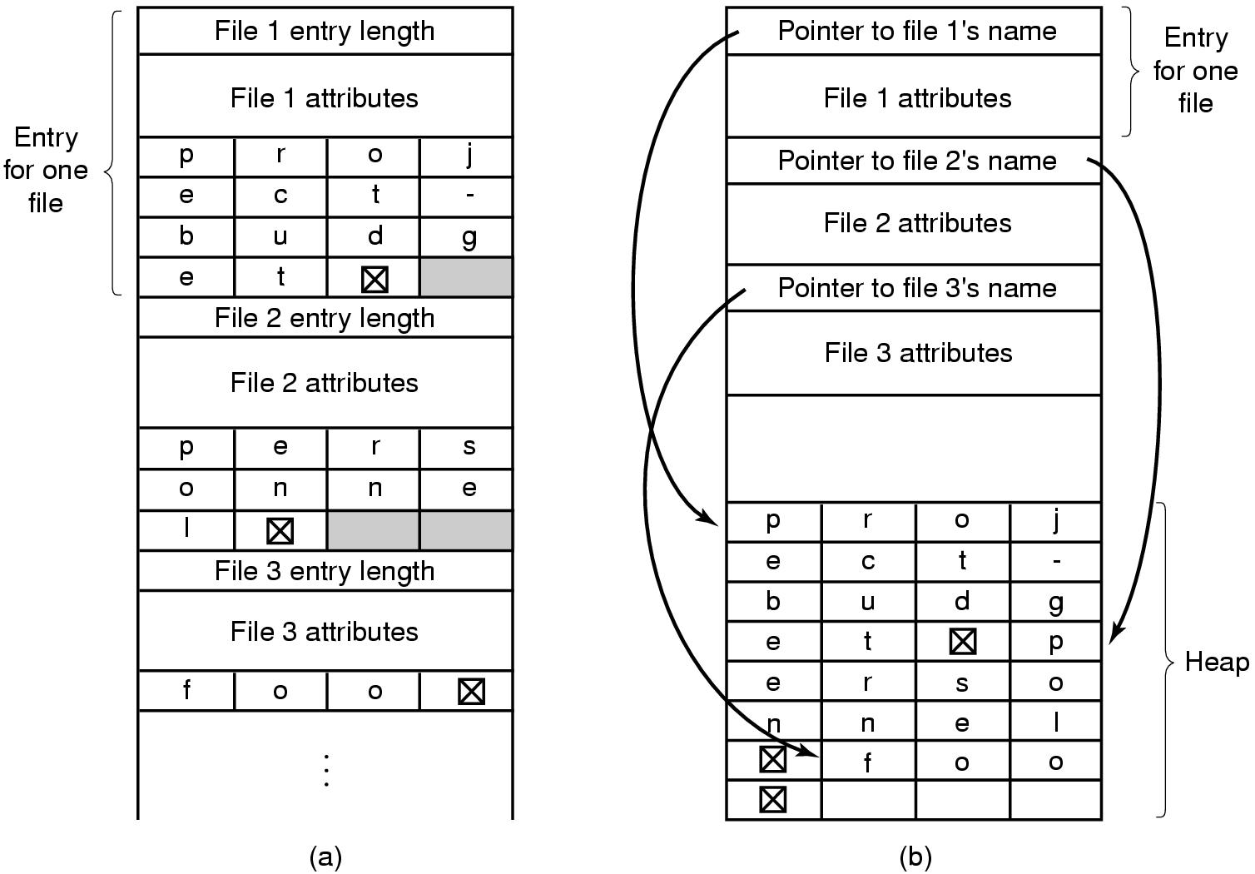
Long File names

Slide 15
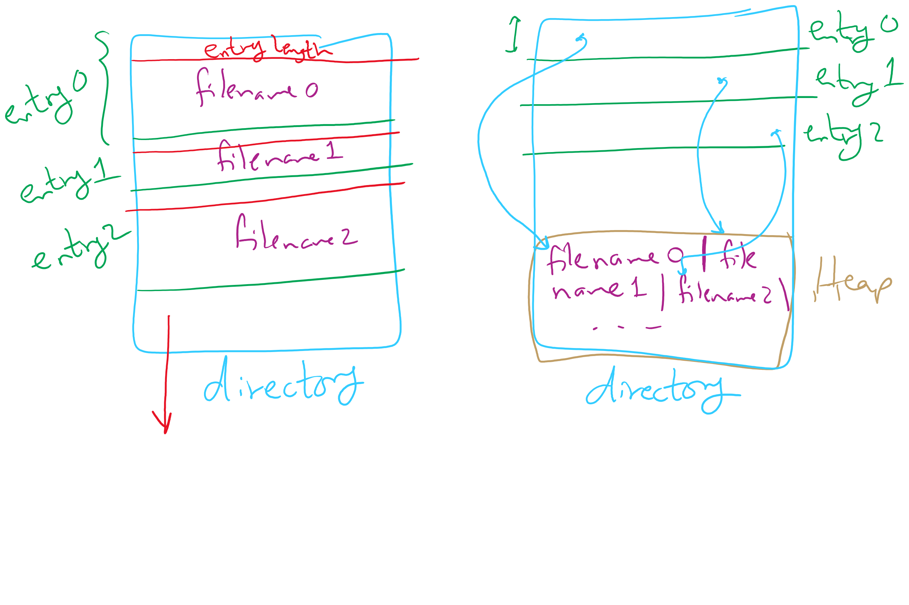
Long File names

Slide 16
Today’s Agenda …
File System Implementation
Optimizing reliability and performance
Low-level device driver issues

Slide 17
Max Partition Size
Block size | FAT-12 | FAT-16 | FAT-32
0.5 KB | 2 MB
1 KB | 4 MB
2 KB | 8 MB | 128 MB
4 KB | 16 MB | 256 MB | 1 TB
8 KB |  | 512 MB | 2 TB
16 KB |  | 1024 MB | 2 TB
32 KB |  | 2048 MB | 2 TB

Slide 18
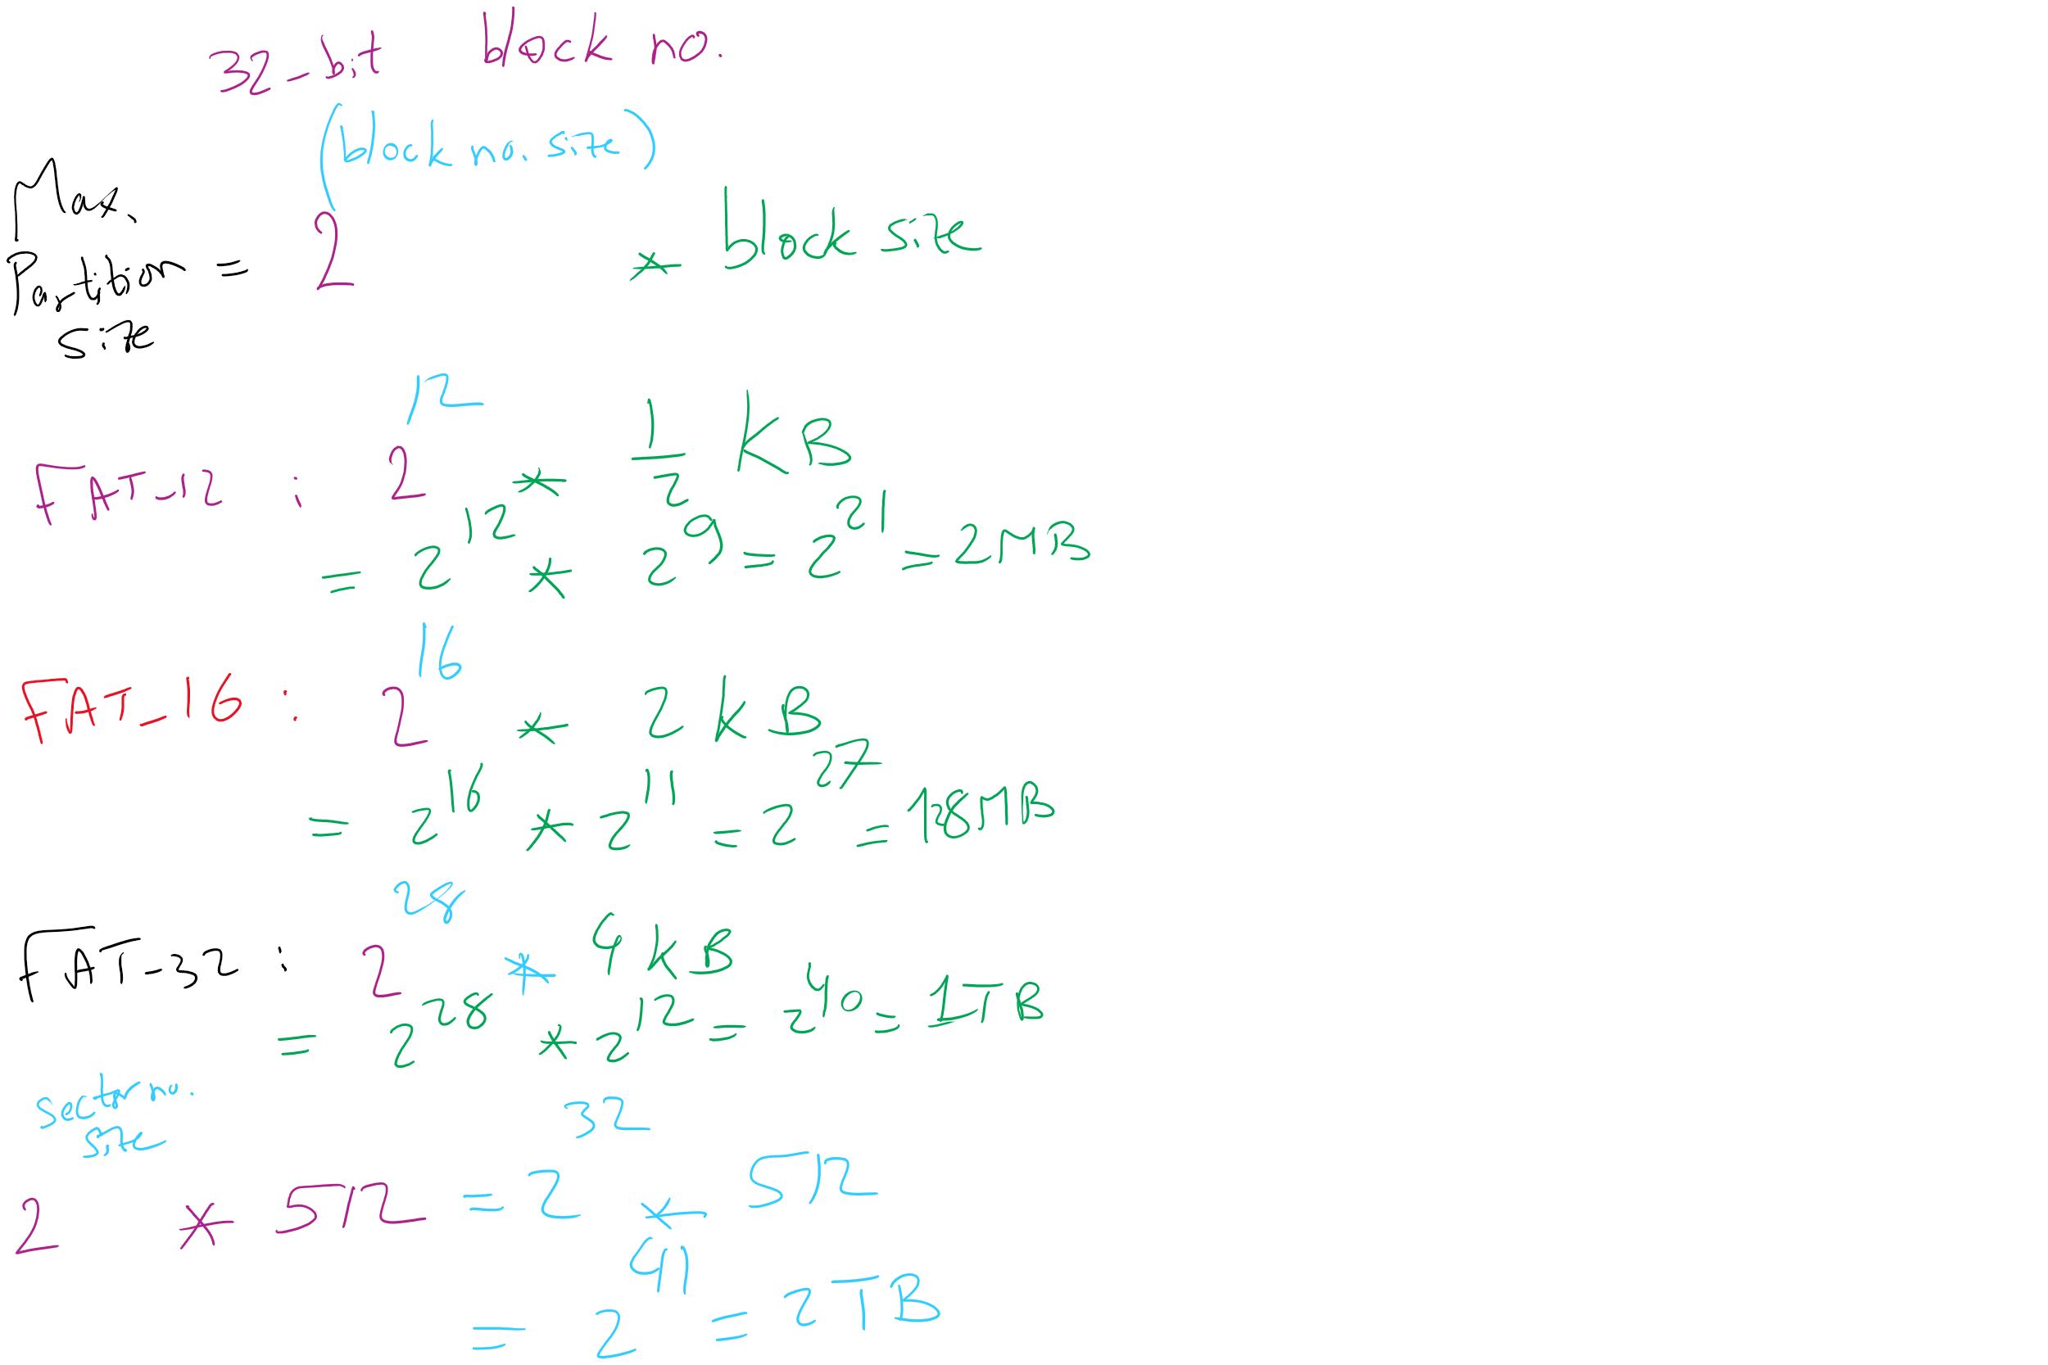
Max Partition Size

Slide 19
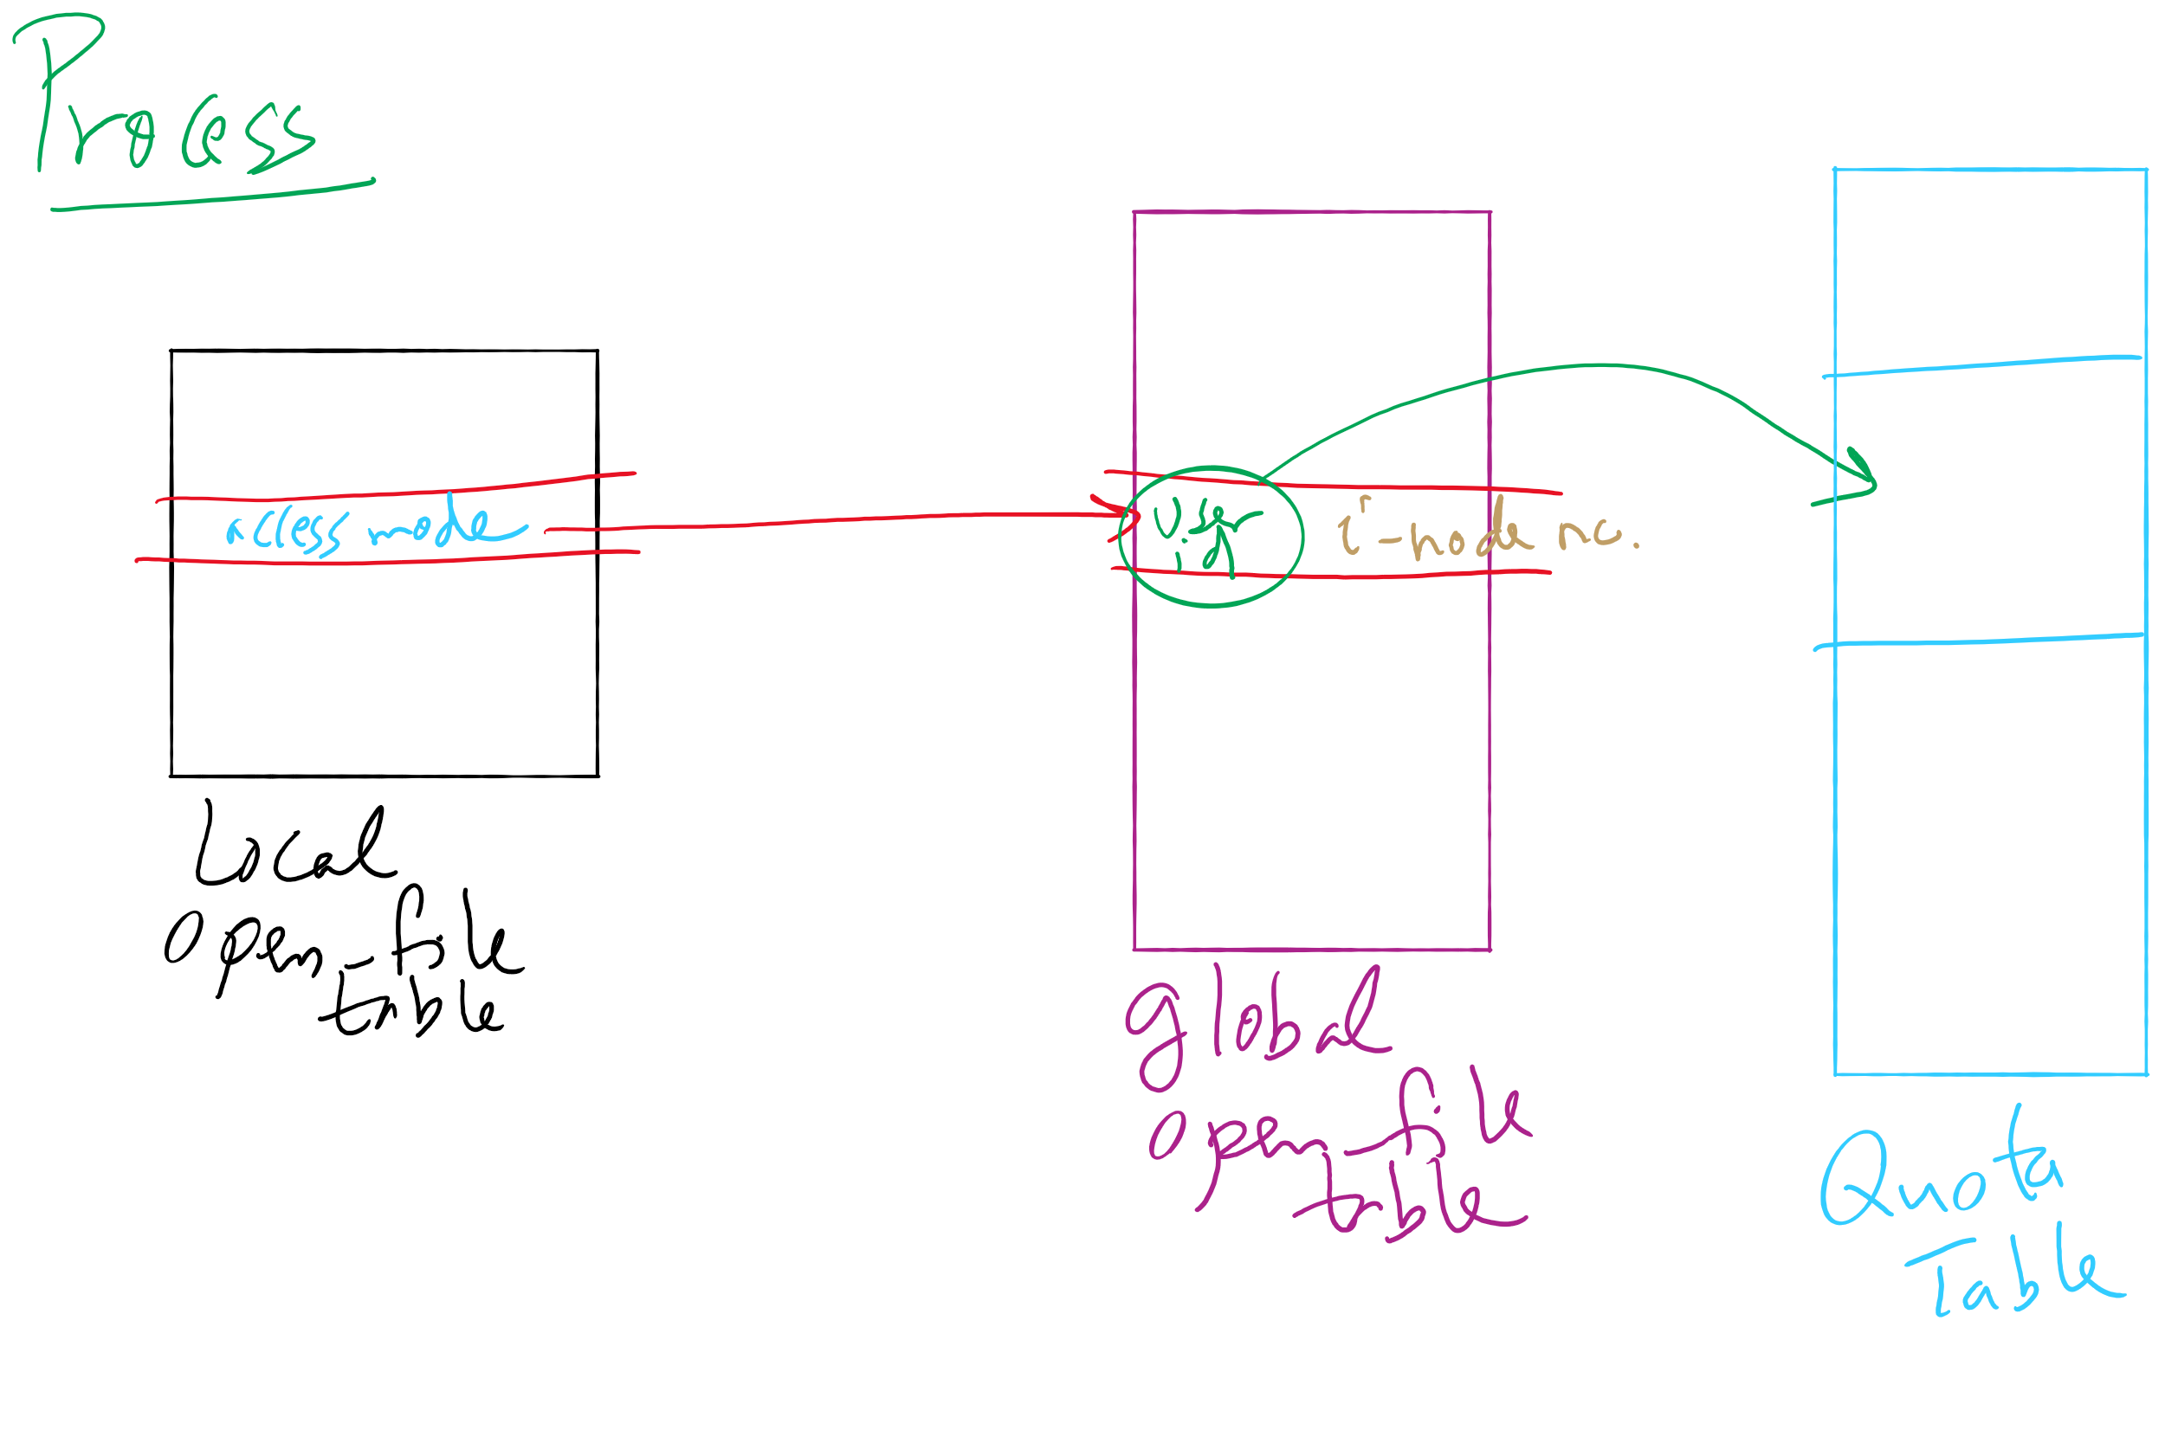
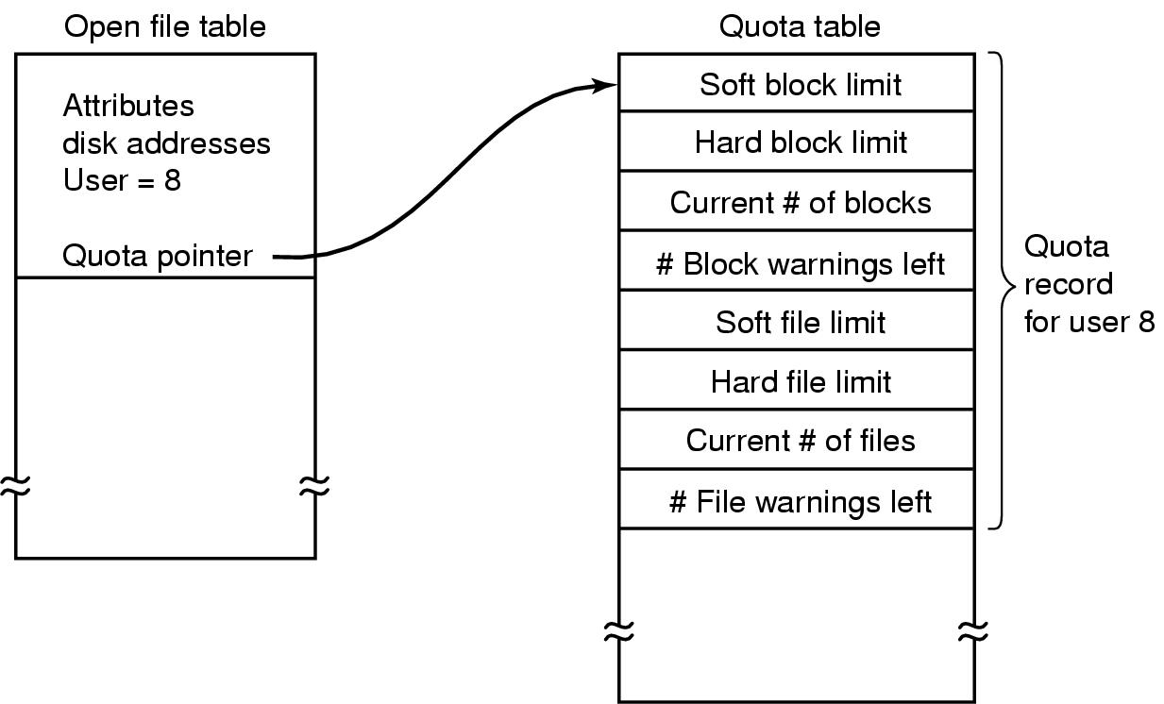
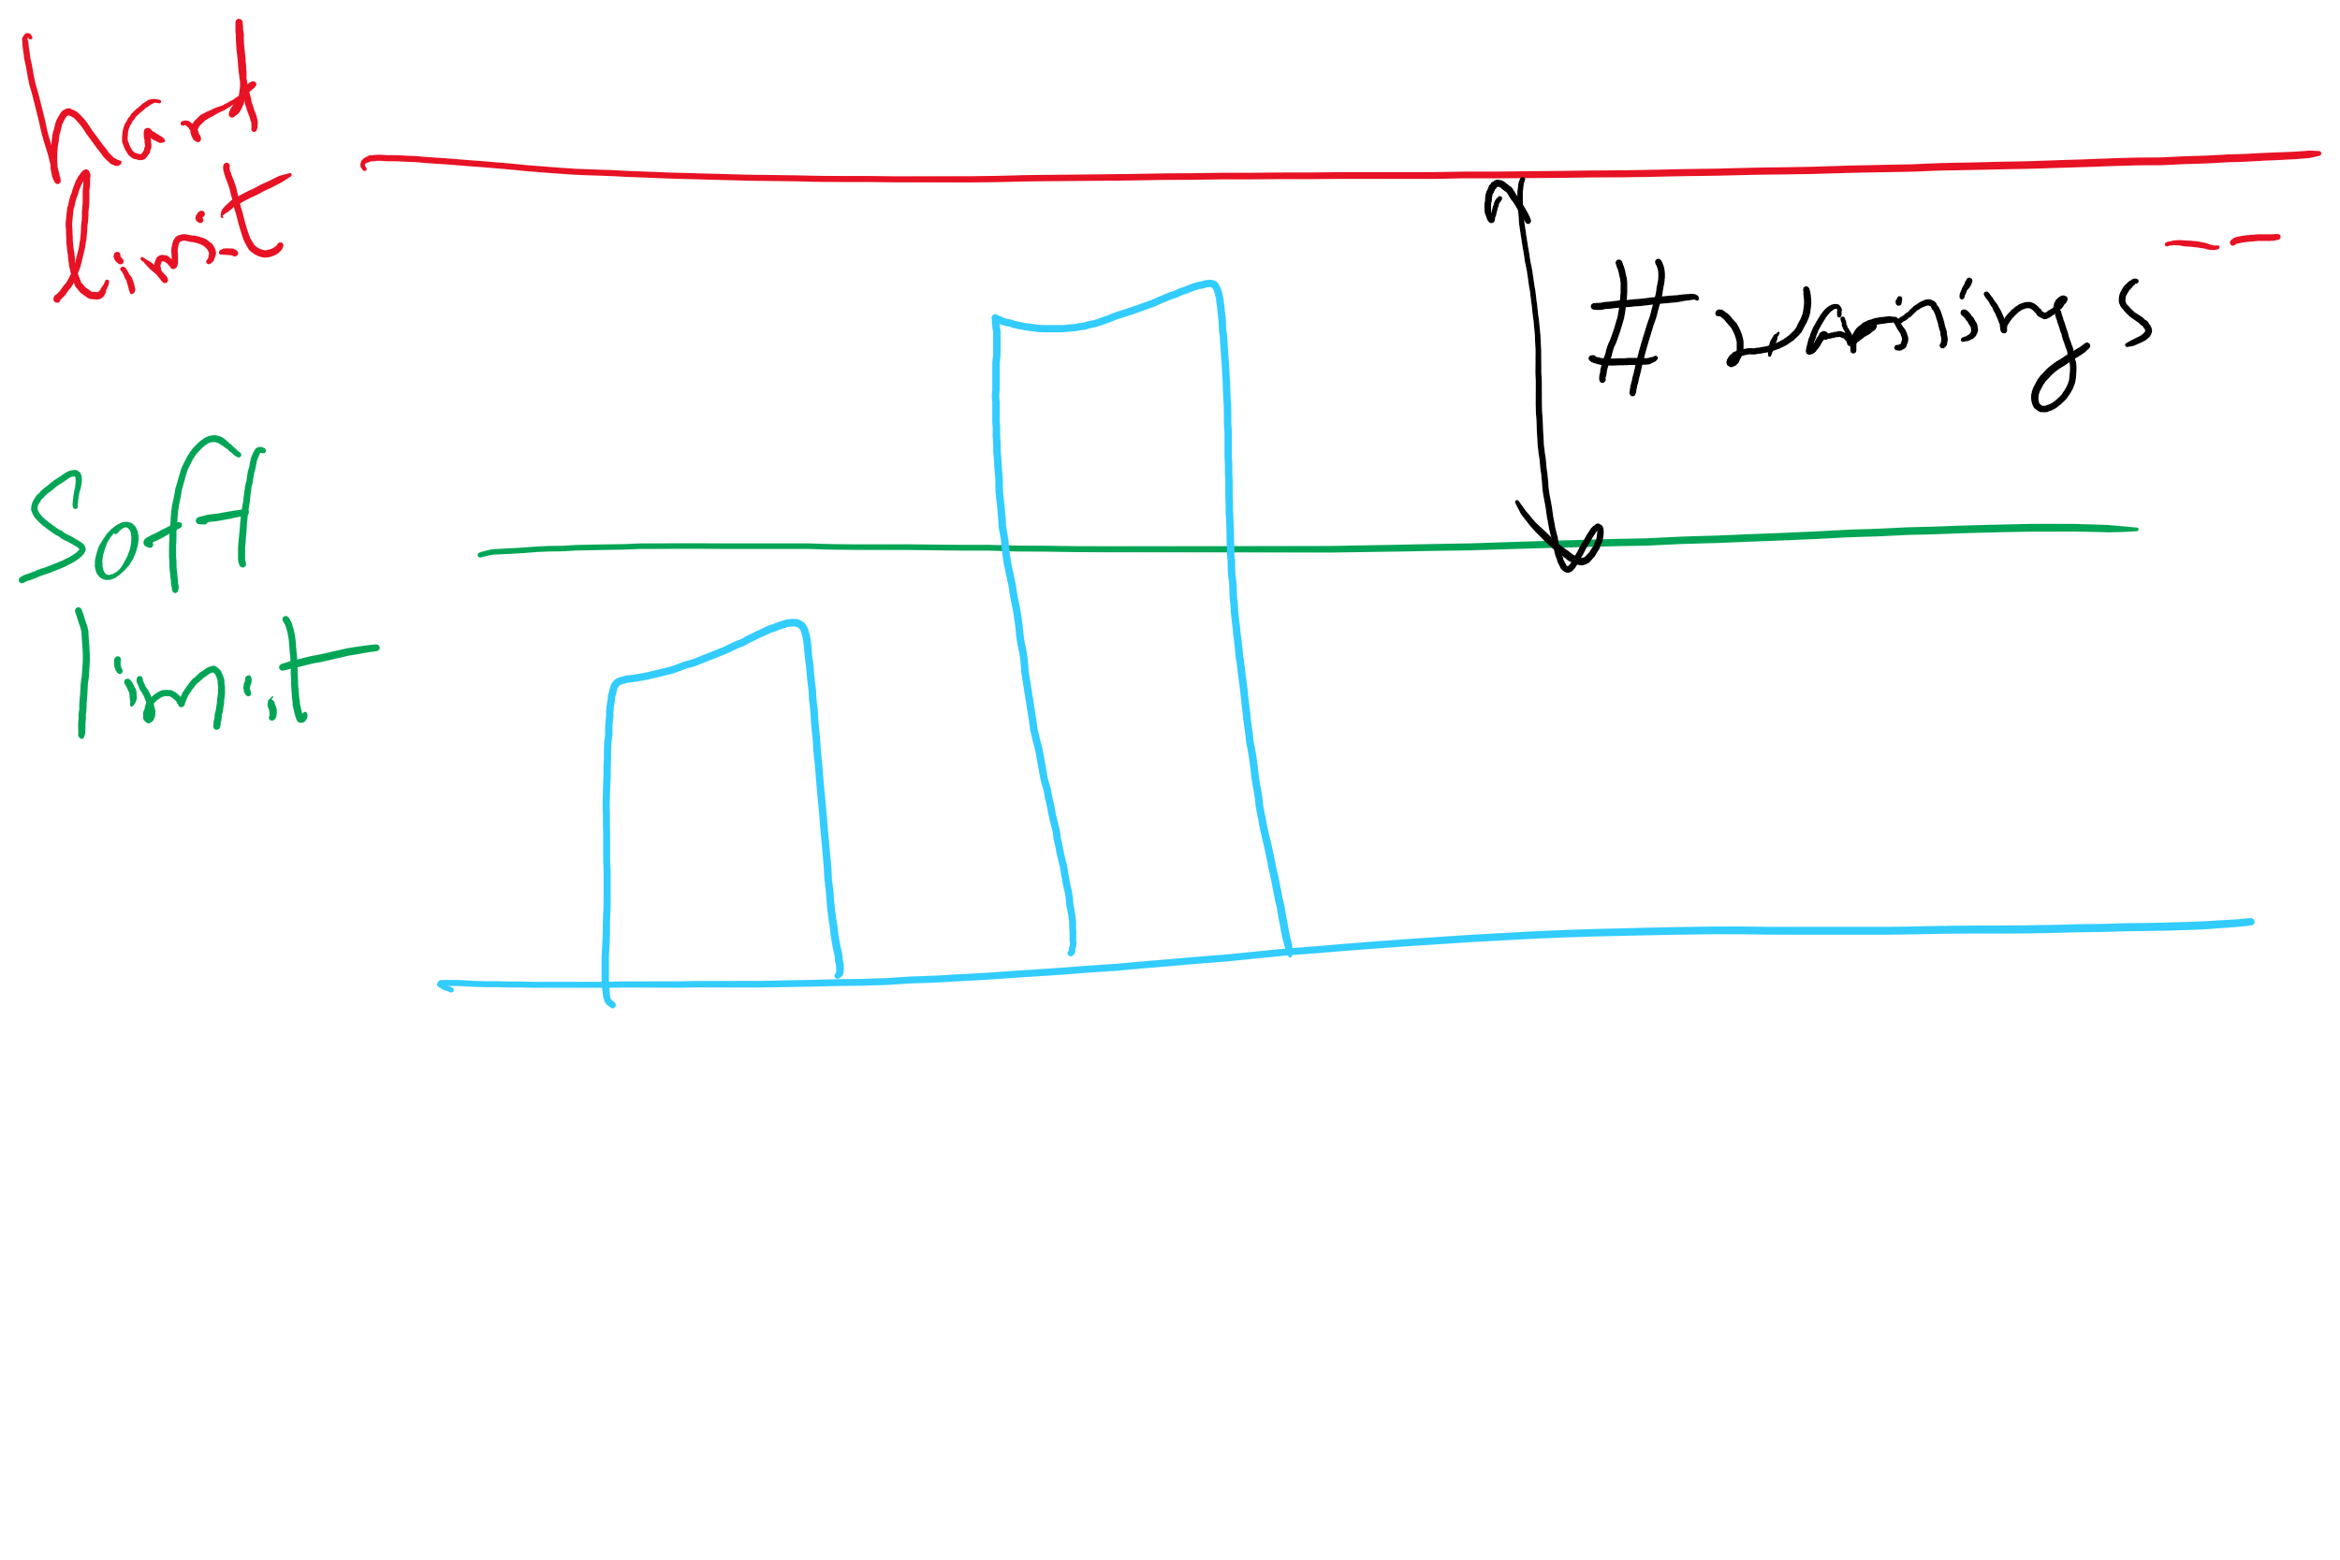
File-related kernel structures: open file tables and disk quotas

Slide 20
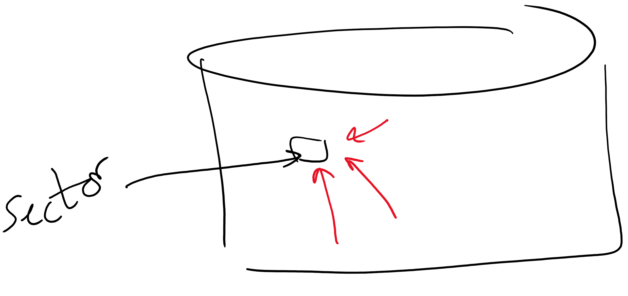
Structure of a disk sector
Preamble contains information about the sector
Sector number & location information
Data is usually 256, 512, or 1024 bytes
ECC (Error Correcting Code) is used to detect & correct minor errors in the data
Preamble
Data
ECC

Slide 21
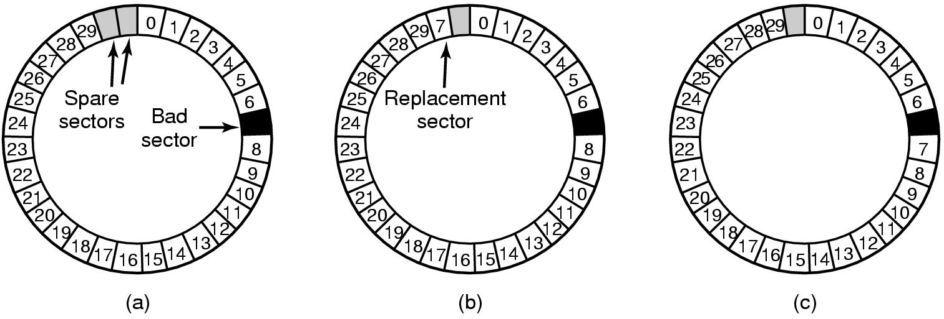
When good disks go bad…
Disks have defects
In 3M+ sectors, this isn’t surprising!
ECC helps with errors, but sometimes this isn’t enough
Disks keep spare sectors (normally unused) and remap bad sectors into these spares
If there’s time, the whole track could be reordered…

Slide 22
RAIDs, RAIDs, and more RAIDs
Stripe
strip
strip
RAID 0
(Redundant Array of Inexpensive Disks
RAID 1
(Mirrored copies)
RAID 4
(Striped with parity)
RAID 5
(Parity rotates through disks)

Slide 23
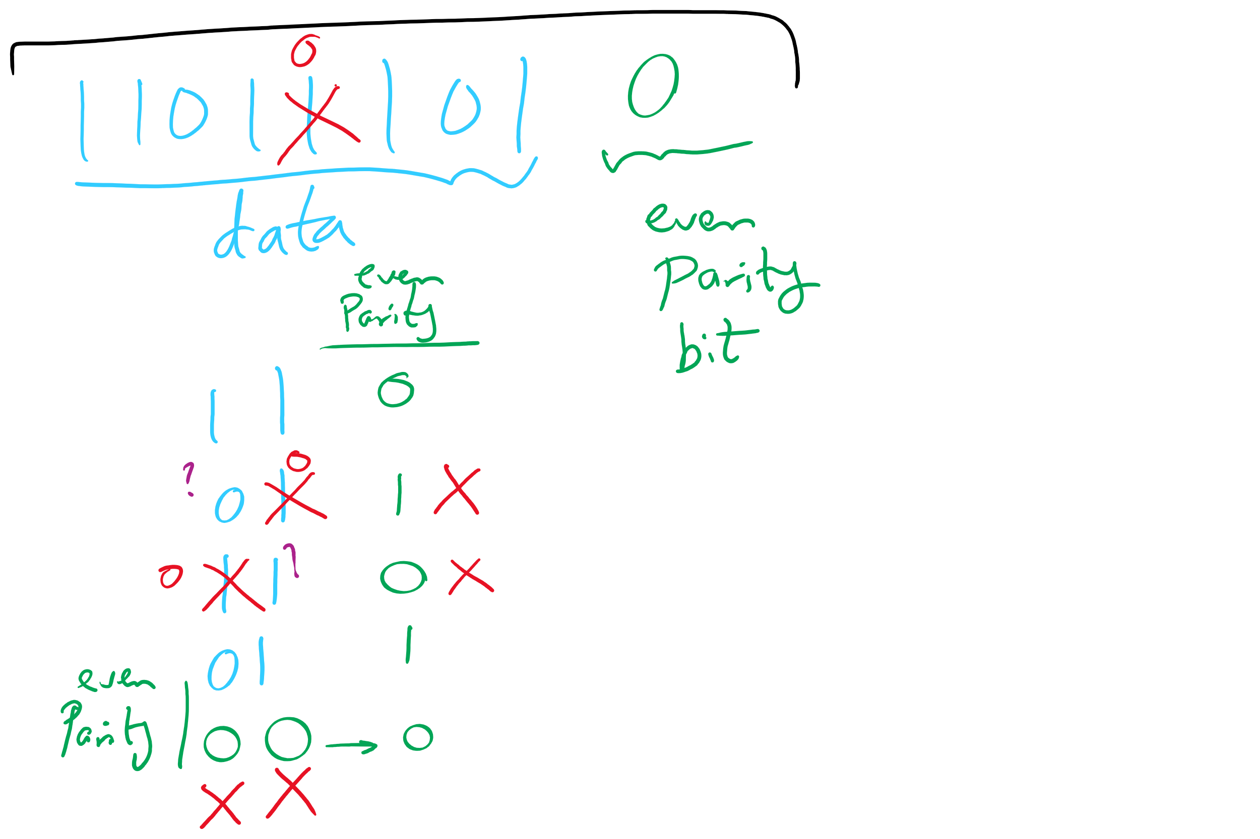
Parity Examples

Slide 24
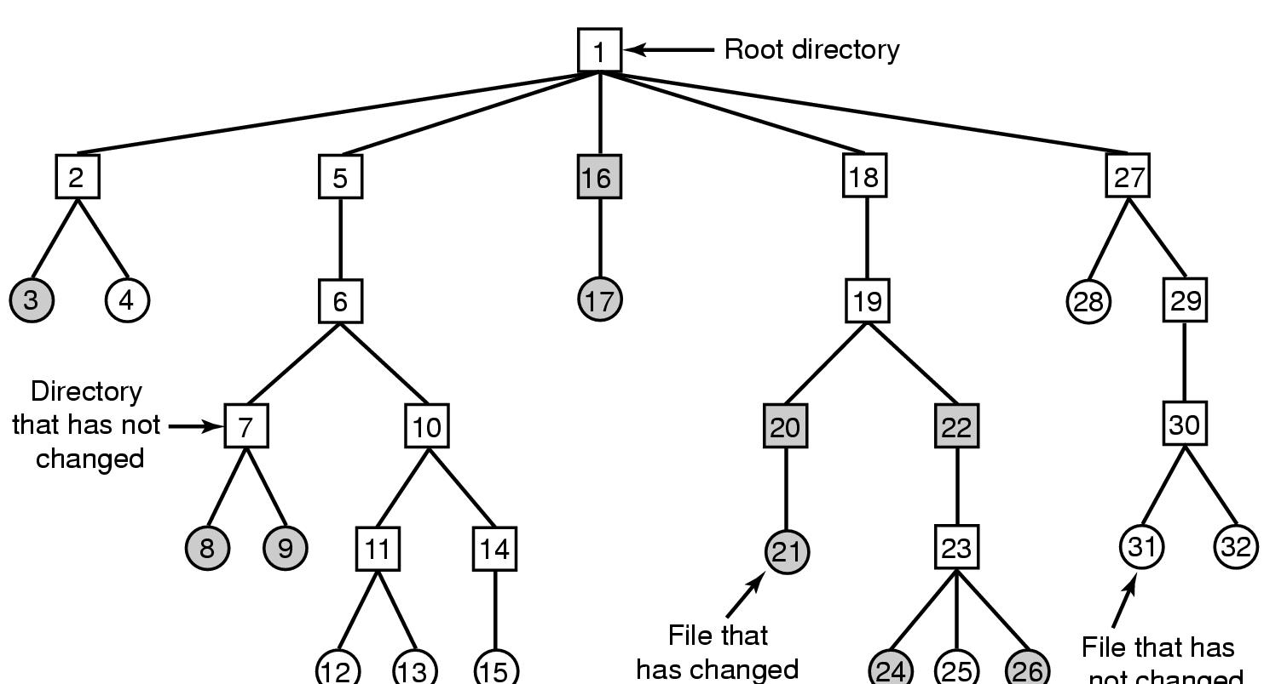
Backing up a file system
A file system to be dumped
Squares are directories, circles are files
Shaded items, modified since last dump
Each directory & file labeled by i-node number
File that has
not changed

Slide 25
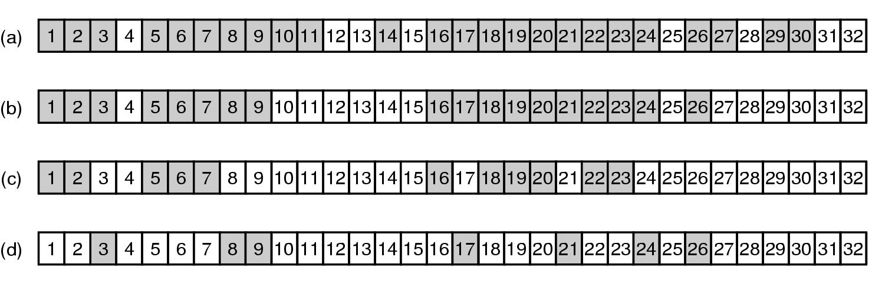
Bitmaps used in a file system dump

Slide 26
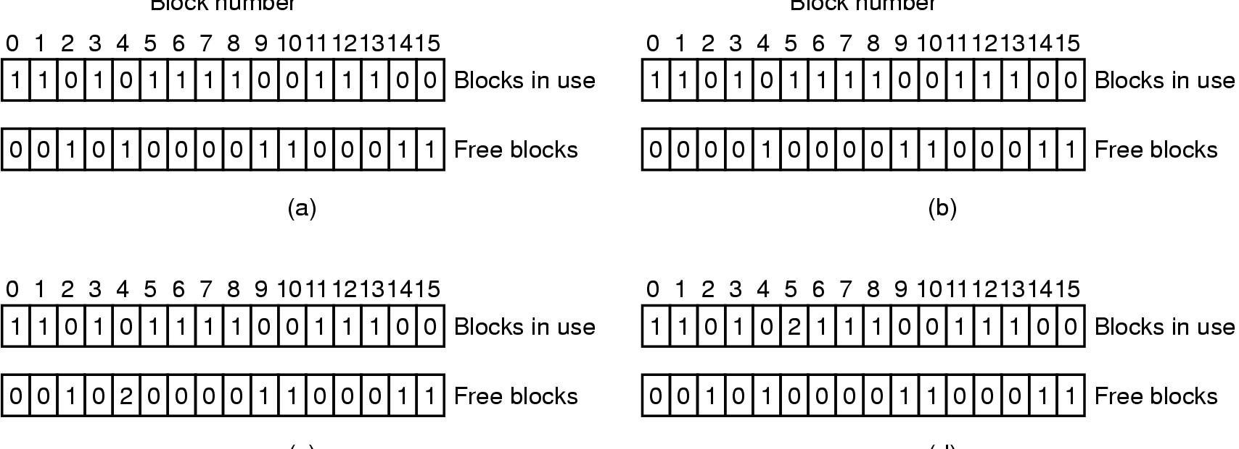
Checking the file system for consistency
Consistent
Missing (“lost”) block
Duplicate block in free list
Duplicate block in two files

Slide 27
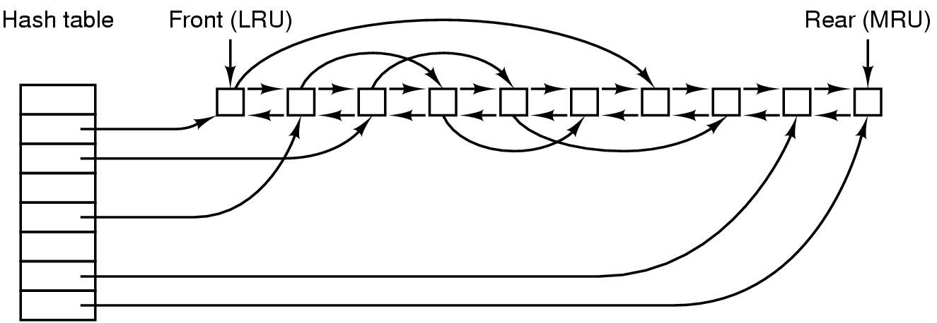
File block cache data structures

Slide 28
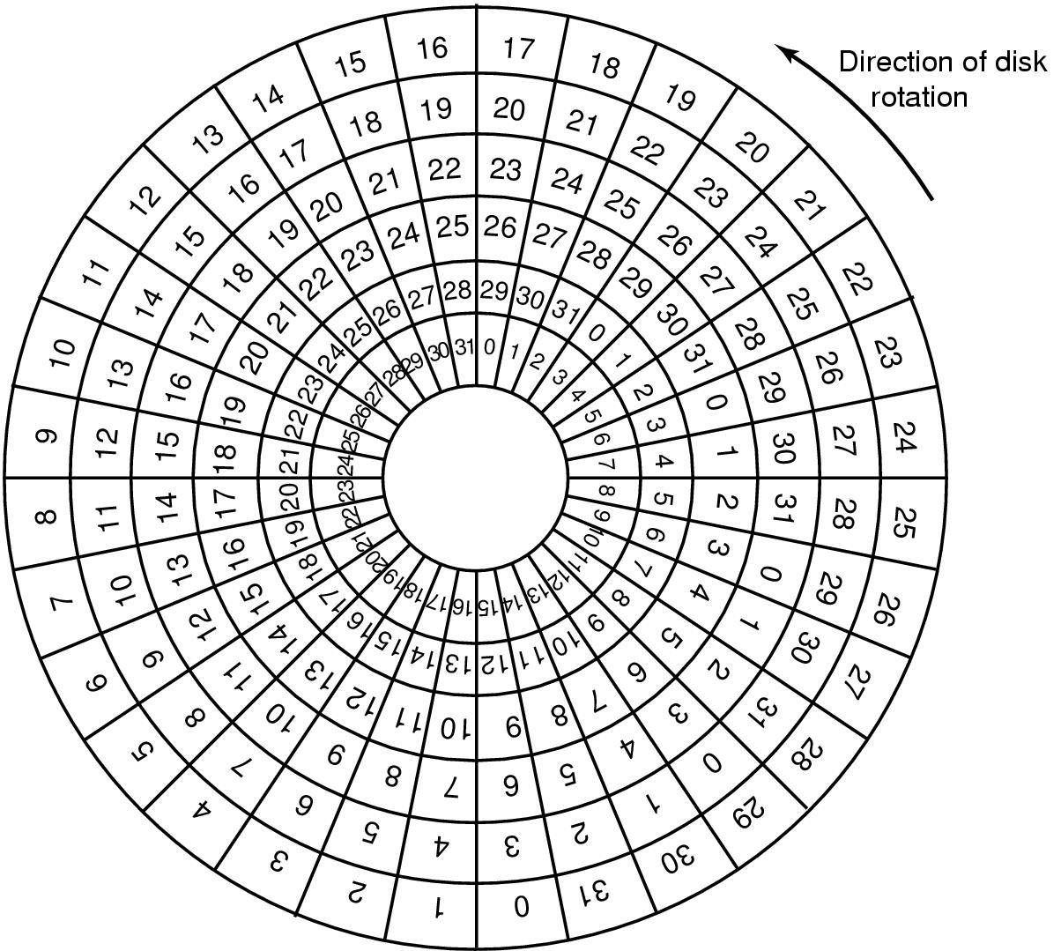
Sector Skew
Sectors numbered sequentially on each track
Numbering starts in different place on each track: sector skew
Allows time for switching head from track to track
All done to minimize delay in sequential transfers

